Slide 1
2012 Annual Report Pueblo Interagency Dispatch Center

Slide 2
Narrative
The 2011 fire season rolled into 2012 with continued drought conditions and consistent fire activity throughout the year. Although fire occurrence and acreage was less than the 2011 season, the fires within the Pueblo Zone were intense involving more urban interface areas; The first reported fire with significant acreage in the Pueblo Zone occurred on January 18 in Kansas on the Potawatomi Tribal Trust land (Buskirk – 60 acres), (Ty 4 IMT) a starting point for the state of Kansas, who’s last large fire was reported on December 6th – Calfex Complex (Riley County – 6278 acres). In Colorado , there were a total of 5 large fires, the first occurred on March 26, 2012, the Lower North Fork (T 1 IMT- Harvey) Fire, ,located in Jefferson county that burned to 4,140 acres , damaging/destroying 24 homes and resulting in three fatalities. On June 23rd, two large fires started on the PSICC- the Treasure Fire (T 3 Team) Fire, located in Lake County on the Leadville Ranger District started at 10,000 feet burning to 420 acres. The Waldo Fire (T 3 Team) located in El Paso County on the Pikes Peak Ranger District burned 18,947 acres, damaging/destroying 347 homes and resulting with 2 fatalities. During the first day, the Pueblo Zone Type 3 Incident Management team was mobilized, along with key members from the Springer IMT 2 and started initial attack and with El Paso County evacuated 11,200 people, and ordered a (T 1 IMT-Harvey). In conclusion a total of 31, 0000 people were evacuated. The last Colorado large fire of the season was the Wetmore fire, (T 2 IMT Esperance) starting October 23rd, Custer County, on the San Carlos Ranger District burned 1,998 acres, damaged/destroyed 15 homes.
All Federal agencies within the zone brought in severity resources to support local IA and Pueblo Dispatch. The Pike-San Isabel National Forest hosted a multitude of Regional pre-suppression crews, aircraft and engines utilizing most of the resources within the first 24 hours of their arrival on initial attack or support to larger incidents within the zone.
Pueblo Dispatch activated expanded dispatch for 80 days and ran 24 hour staffing for 86 days. We started 7 day staffing in early April and will continue through the New Year. The Center was staffed with 3 primary dispatchers and 5 new seasonal dispatchers. Due to primary staff vacancies we were supported with 5 detailed Center Managers, 1 Detailed Assistant Center Manager and 1 Lead Dispatcher. We ordered in 57 Dispatchers to support our operations in Aircraft, Initial Attack and Expanded Dispatch. By December 2 primary positions were filled; the PSICC has two vacancies the Center Manager and an Initial Attack Dispatcher. The Rio Grande National Forest has a new position a GS 5/6 18/8 Logistics Dispatcher that will be flown shortly. All in all it was a successful year.
Additional successes, challenges and fun facts captured during the 2012 year. March: The center overcame the challenges of a City Power Outage during the mobilization and support of Lower North Fork fire, where we activated our COOP plan. In April and May the Center put on two D-110 classes, hired 5 dynamic seasonal dispatchers, conducted a 40 hour Dispatch Academy, hosted the Pueblo Zone Interagency Dispatch Workshop, successfully completed a BLM National and a R2 dispatch review and converted all of ROSS self – status accounts to the NAP security program and hosted a state congressional tour. In June, ROSS was down for several days due to a faulty upgrade connection with the USDA during the Springer, Treasure and Waldo Fire. Expanded dispatchers were challenged with supporting 3 Incident Management Teams, and succeeded in their support by going back to the basics, strong work ethics and positive attitudes. In June we had reports of metal falling from the sky (meteor showers) in Central Colorado causing a voluntary temporary shutdown of air operations. The center processed 180 airline travel request to mobilize or demobilize personnel to incidents. In July the center had several mass mobilizations of personnel and equipment, twice we mobilized approximately 40 overhead and 40 equipment orders for incidents outside the PIDC Zone. In a separate situation 3 IMT 2 teams were regionally ordered and team members were mobilized in two days. In August, while being mobilized to the Ditch Fire – the Tatanka IHC crew stopped in Larkspur FPD and put out 2 very active train started fires. August 7 PIDC dispatchers once again mobilized another 40 personnel /equipment to support out of area incidents. For the first time in the Center’s history - we ran out of engines available for out of zone assignments on three different occasions. A program started 6 years ago with Denver Fire that involved training their personnel in Dispatch positions proved itself over and over again. During the many mobilizations and incidents within our zone – their wildland fire team supported Pueblo with quality personnel willing to assist at a moment’s notice, however needed. Thanks to all of the agencies and Fire Board for your support this year with the purchase of much needed equipment and funding for the dispatch positions.

Slide 3
Incident Totals

Slide 4
1,502 Incidents

Slide 5
Incidents by Agency

Slide 6
Colorado Incidents by County-259

Slide 7
Kansas Incidents by County-40

Slide 8
Incidents by Hour

Slide 9
Incidents by Day

Slide 10
Red Flag Warning Incidents-211

Slide 11
5 Year Average of Incidents-1,404

Slide 12
Fires and Acres Totals

Slide 13
Fires and Acres by Agency

Slide 14
PSICC-Fires and Acres

Slide 15
RGF-Fires and Acres

Slide 16
RGD, SLI-FMU-Fires and Acres

Slide 17
County Fires and Acres

Slide 18
335 Fires for 86,878 Acres by Month

Slide 19
Human and Lightning Fires by Month

Slide 20
5 year Average-330 Fires, 103,871 Acres

Slide 21
2012 Resource Orders
Overhead, Equipment (Engine’s), Aircraft and Crew – In/Out of Zone Assignments

Slide 22
Overhead In Zone Incidents
Pueblo Reload Tanker Base Support CO-PSF-000005 | SLV-PLC Severity CO-SLD-000631
RIO Grande NF Fire Support CO-RGF-000706 | PSICC NF Support 2012
PSICC Severity CO-PSF-000604 | Lower North Fork CO-JEX-000176
Ditch Creek CO-PSF-001060 | Caylor CO-PSF-000125
PBC Support 2012 CO-PBC-000016 | Springer CO-PSF-000556
Lost Turtle CO-PSF-000448 | Wetmore CO-CUX-001403
Treasure CO-PSF-000633 | Alamosa NWR Severity CO-ALR-000517
Arkansas CO-PSF-000521 | Waldo Canyon CO-PSF-000636
BLM National Severity CO-RGD-000767 | Gold Camp CO-PSF-000021
ROMO Severity CO-FFP-000563 | PSICCC NF SUPPORT 2012 CO-PSF-000142
Great Sand Dunes Severity CO-GSP-000532 | Platte River CO-PSF-000242
Cheetah CO-LSX-000738 | Monument Helibase Support CO-PSF-000399
Frisco Canyon CO-LSX-001180 | Weber CO-PSF-000495
Waldo Canyon Baer CO-PSF-000728 | Pike San Isabel NF ABCD Misc. CO-PSF-000555
Turkey Ridge CO-RGD-001010 | Mid-Plains Severity KS-QUR-000606
KS Severity 2012 KS-QUR-001120 | West Eureka KS-MCR-000047

Slide 23
Overhead Out of Zone Incidents
2012 TNF ABCD MISC AZ-TNF-00002 | Stafford CA-SHF-002894
Bull Flat AZ-FTA-000060 | Williams CA-ANF-004803
Charley AZ-TNF-000967 | Rush CA-NOD-003490
Mistake AZ-TNF-000937 | Jawbone CA-CDD-011542
TNF September Support CA-TNF-002077 | Fort Complex CA-KNF-005659
CHIPs CA-PNF-001001 | Bagley Complex CA-SHF-002744
READING CA-LNP-003115 | GOFF CA-KNF-005533
Lost CA-NOD-003373 | Salt Creek CA-SHF-002521
Wrigley CO-GRD-000455 | Hewlett CO-ARF-000228
Lower North Fork Review Team CO-COS-000002 | High Park CO-LRX-000329
Brush Creek CO-WRD-000429 | 2012 MAFFs Refresher CO-R02-0000006
Rocky Mountain RMCC Support CO-RMC-000001 | ICS CO-RMR-000102
R2-FY12 Staging/Preposition | Little Sand CO-SJF-000133
2012 ARF ABCD Miscellaneous CO-ARF-000001 | Pine Ridge CO-GRD-000275
2012 ARF Support CO-ARF-000005 | Powell Complex CO-WRD-000434
2012 Jeffco ATB Support- May CO-ARF-000199 | Roach CO-ARF-000838
2012 Jeffco ATB Support- July CO-FTC-000545 | R2 Severity- Fire Prevention CO-R02-0000013
2012 Jeffco ATB Support- August CO-ARF-000720 | R2 Regional Office Support CO-R02-000003
2012 FTC Support CO-FTC-000002 | Stuart Hole CO-AFR-000305
Air Park CO-SUA-000618 | Sunrise Mine CO-UPD-000073
BEAR CO-WRD-000433 | Weber CO-SJD-000271
BLM- Colorado National Severity CO-CSO-000002 | Hwy 13 CO-GFX-000729
Brushy Mountain CO-MEX-000104 | Vallecito CO-SJF-001038
Conway CO-LSD-000457 | Fern Lake CO-RMP-000975
Galuchie CO-ARF-000133 | 2012 BOF Large Fire Support ID-BOF-000467
2012 NICC Support ID-FCF-000001 | 2012 R1 Large Fire Support MT-R01-000010
Avelene ID-SWS-000452 | BAER Team East Sarpy MT-CRA-000101
Benwalk ID-BOD-000432 | Butler MT-LNF-000804
Cave Canyon ID-STF-000423 | Chrandal Creek MT-BRF-005432
Curran ID-STF-000503 | Dahl MT-SOS-000013
Halstead ID-SCF-012151 | Delphia MT-SOS-000070
Karney ID-SWS-000932 | Eagle Creek MT-NCA-012058
Kinyon Road ID-TFD-000263 | East Sarpy MT-CRA-000085
McGuire ID-NPF-000531 | Elbow Pass Complex MT-LCF-002085
Mustang Complex ID-SCF-012190 | Elevation Mountain MT-SWS-000438
Sheep ID0NPF-000604 | Nineteen Mile MT-CES-000122
Springs ID-BOF-000646 | Rosebud MT-SOS-000075
Trinity North ID-BOF-000667 | Rosebud Complex MT-EAS-000007
Trinity Ridge ID-BOF-000628 | Sawtooth MT-BRF-005563
Trinity Ridge West ID-BOF-000745 | Skipsted MT-SOS-000040

Slide 24
Overhead Out of Zone Incidents
Wesley ID-PAF-012076 | Southeast Montana Complex MT-MCD-000035
MS Canyon 252 Oil Spill LA-DLR-201001 | West Garceau MT-FHA-000123
2012 BLM National Severity MT-MCD-100045 | Douthit NE-NES-121133
Fair Field Creek NE-NES-120674 | 2012 Misc. ABC NM-SNF-000001
Region 23 Complex NE-NES-121135 | 2012 HTF Preposition NV-HTF-120312
Wellnitz NE-NES-121137 | Elko BLM Severity 2012 NV-EKD-100678
2012 Gila ABCD Misc NM-GNF-000001 | Holloway NV-WID-020210
Baldy NM-GNF-000121 | Elko Mobilization Center 2012 NV-EIC-101349
Little Bear NM-LNF-000007 | White Rock NV-ELD-000041
Whitewater NM-GNF-000143 | FEMA R2 Hurricane Sandy Lakehurst NIMO2 Activation NJ-FEMA-130001
FEMA R2 Hurricane Sandy Ft. Dix Mob Center Support NJ-FEMA-130009 | FEMA R2 Hurricane Sandy NY Road Clearing NY-FEMA-130004
Northeast Area Hurricane Sandy ESF4 Activation WI-R09-000005 | 0537- Pole Creek OR-DEF-000537
0172 2012 Redmond ATB Support OR-DEF-000172 | 2012 WIF ABC Misc OR-WIF-120001
2012 MAF ABCD Misc OR-MAF-012001 | Barry Point OR-FWF-120680
Bonita Complex OR-VAD-000079 | Box Creek UT-FIF-000083
Butte OR-UPF-120132 | Lost Lake UT-FIF-000082
Cache Creek OR-WWF-000742 | Red Ledges UT-UWF-000783
Long Draw OR-VAD-000067 | Seeley UT-MLF-002129
Miller Homestead OR-BUD-020072 | Wolf Den UT-VLD-000133
Ten Mile Complex OR-VAD-000136 | Easter Complex VA-VAF-201257
Waterfalls 2 OR-WSA-000064 | Point 2 VA-VAF-201280
Cascade Creek WA-GPF-000563 | Fontenelle WY-BTF-000006
Okanogan Complex WA-OWF-000610 | Gilead WY-BHF-000520
Yakima Complex WA-OWF-000583 | Horsethief Canyon WY-BTF-000034
Wenatchee (River) Complex WA-OWF-000559 | Oil Creek WY-CPS-012137
Table Mountain Complex WA-OWF-000642 | Russels Camp WY-COX-012096
WSO National Severity WY-CPC-012113 | Seminoe WY-RAD-000229
2012 SHF Support WY-SHF-000246 | Sheep Herder Hill Complex WY-CPS-012070
Alpine Lake WY-WRA-000490 | Skull Creek Complex WY-CPS-012070
Arapaho WY-ALX-012131 | Squirrel Creek WY-MBF-012139
Cow Camp WY-MBF-012069 | WBD- Long Term Severity WY-WBD-000237
Ferris WY-RAD-000269

Slide 25
1,350 Requests for 17 Incidents

Slide 26
867 Requests for 150 Incidents

Slide 27
Crew In of Zone Incidents
PSICC NF Support, CO-PSF-142 | Treasure, CO-PSF-633
Lower North Fork, CO-JEX-176 | Waldo Canyon, CO-PSF-636
Westcreek, CO-TLX-201 | Trout Creek, CO-PSF-648
Rosado, CO-SHX-235 | Cheetah, CO-LSX-738
Platte River, CO-PSF-242 | Mill Gulch, CO-PSF-793
Nepesta, CO-PUX-423 | Derringer, CO-PSF-924
Weber, CO-PSF-495 | Turkey Ridge, CO-RGD-1010
Arkansas, CO-PSF-521 | Ditch Creek, CO-PSF-1060
Springer, CO-PSF-556 | Frisco Canyon, CO-LSX-1180
Spikebuck, CO-RGD-588 | Wetmore, CO-CUX-1403
PSICC NF Severity, CO-PSF-604

Slide 28
Crew Out of Zone Incidents
Wallow, AZ-ASF-110152 | Wolf, CO-WRD-000579
Fern Lake, CO-RMP-000975 | X Rock, CO-LPX-000208
Chaining, CO-DTX-000412 | R2 FY12 Staging/Preposition, CO-R02-000004
Hwy 13, CO-GFX-000729 | Knox Canyon, ID-EIX-012018
Middle Elk, CO-WFR-000711 | 2012 NICC Support, ID-FCF-000001
Brush Creek, CO-WRD-000429 | Black Beach, MT-CES-000119
Cabin Creek, CO-GUX-000039 | Wellnitz, NE-NES-121137
Cross Canyon, CO-MNX-000944 | 2012 Large Fire Preparedness/Preposition, NM-R03-000007
Divide, CO-WRD-000580 | Gilead, WY-BHF-000520
East Fork, CO-SJF-000051 | Arapaho, WY-ALX-012131
Hewelett, CO-ARF-000228 | Elk Butte, WY-RSD-000380
High Park, CO-ARF-000039 | FY12 WY-MBF/TBNG Severity, WY-MBF-012162
High Park, CO-LRX-000039* | Ferris, WY-RAD-000269
Mile Marker 125, CO-GND-000036 | Russels Camp, WY-MBF-012096
Roach, CO-ARF-000838 | Sawmill Canyon, WY-CPS-012205
Stuart Hole, CO-ARF-000305 | Squirrel Creek, WY-MBF-012139
Sunrise Mine, CO-UPD-000073

Slide 29
220 Requests for 21 Incidents

Slide 30
50 Requests for 33 Incidents

Slide 31
Engine In Zone Incidents
Pueblo Reload Tanker Base Support, CO-PSF-000005 | Great Sand Dunes Severity, CO-GSP-000532
PBC Support, CO-PBC-000016 | PSICC NF ABCD Misc., CO-PSF-000555
Caylor, CO-PSF-000125 | Springer, CO-PSF-000556
PSICC NF Support, CO-PSF-000142 | PSICC Severity, CO-PSF-000604
Lower North Fork, CO-JEX-000176 | Treasure, CO-PSF-000633
Platte River, CO-PSF-000242 | Waldo Canyon, CO-PSF-636
Round Mountain, CO-PSF-000316 | Trout Creek, CO-PSF-000648
Weber, CO-PSF-000495 | Ditch Creek, CO-PSF-001060
Alamosa NWR Severity, CO-ALR-000517 | Wetmore, CO-CUX-001403
Arkansas, CO-PSF-000521

Slide 32
Equipment (Engines) Out of Zone Incidents
Hobble, AZ-ASD-120384 | West Ash, NE-NES-121132
2012 TNF ABCD Misc., AZ-TNF-000002 | Lutz, NV-HTF-011192
Chips, CA-PNF-001001 | Willow, NV-NNS-101197
ENF Lighting, CA-ENF-016887 | 2012 Large Fire Preparedness/Preposition, NM-R03-000007
Rush, CA-NOD-003490 | White Water Baldy Complex, NM-GNF-000143
TNF August Lighting, CA-TNF-001518 | McIntosh, ND-SRA-121110
Fern Lake, CO-RMP-000975 | Lagoon Creek, OK-PAA-001219
Conway, CO-LSD-000457 | Step Program, OK-CAN-012053
Divide, CO-WRD-000580 | Barry Point, OR-FWF-120680
Hewelett, CO-ARF-000228 | BKF ABCD MISC., SD-BKF-120006
High Park, CO-LRX-000329 | BKF Command and Mob Center, SD-BKF-120842
Little Sand, CO-SJF-000133 | BKF National Severity 2012, SD-BKF-120487
Pine Ridge, CO-GRD-000275 | Long Horn Complex, SD-RBA-120671
NWCFMU State, CO-CRD-000512 | Myrtle, SD-BKF-120655
2012 GMUG Severity, CO-GMF-000141 | Parker Peak, SD-BKF-120501
Sunrise, CO-UPD-000073 | Rosebud Lightning Complex, SD-RBA-121102
Roach, CO-ARF-000838 | White Draw, SD-BKF-120485

Slide 33
Equipment (Engines) Out of Zone Incidents
2012 ARF ABCD MISC., CO-ARF-000001 | Canyon Country BLM Severity, UT-MOD-002121
San Juan NF ABCD Misc., CO-SJF-000007 | Little Pine, UT-DIF-120777
County Line, FL-FNF-012017 | Pinyon UT-NWS-000692
Benwalk, ID-BOD-000432 | Alpine Lake WY-WRA-000490
Halstead, ID-SCF-012151 | FY 12 R2 Severity BHF WY-BHF-000333
Minidoka, ID-STF-000441 | FY12 WY-MBF/TBNG Severity WY-MBF-012162
Trinity Ridge, ID-BOF-000628 | Gilead WY-BHF-000520
Old US2, MI-OTF-090701 | Horsethief Canyon WY-BTF-000034
Eagle Creek, MT-NCA-012058 | Jacobs, WY-WAX-000306
2012 KNF ABCD Misc., MT-KNF-201202 | Little Boxelder, WY-COX-012344
Miles City Severity, MT-MCD-000017 | Medbow Routt Support, WY-MBF-012381
Camp 5, NE-NBF-120489 | Sheepherder Hill, WY-NAX-012414
Douthit, NE-NES-121133 | SHF Severity, WY-SHF-000232
Fair Field Creek, NE-NES-120674 | Squirrel Creek, WY-MBF-012139
Mossagate, NE-NBF-120715 | Seminoe, WY-RAD-000229
Region 23 Complex, NE-NES-121135 | WBD- Long Term Severity, WY-WBD-000237

Slide 34
380 Requests for 19 Incidents

Slide 35
209 Requests for 66 Incidents

Slide 36
Aircraft In Zone Incidents
PSICC NF Support 2012, CO-PSF-142 | Trout Creek, CO-PSF-648
Lower North Fork, CO-JEX-176 | Polhemus, CO-PSF-701
Westcreek, CO-TLX-201 | FA #709, CO-PSF-709
Platte River, CO-PSF-242 | Waldo Canyon BAER, CO-PSF-728
Eagle Cliff, CO-JEX-368 | Y Camp Road, CO-PSF-734
Pole Creek, CO-PSF-513 | Cheetah, CO-LSX-738
Arkansas, CO-PSF-521 | Tanner, CO-PSF-768
Tallahassee Creek, CO-RGD-543 | Mill Gulch, CO-PSF-793
PSICC ABCD Misc., CO-PSF-555 | FA #823, CO-RGD-823
Springer, CO-PSF-556 | FA #857, CO-PSF-857
Locke Mtn., CO-PSF-567 | Mineral, CO-RGD-901
FA #568, CO-RGF-568 | Rice Mountain, CO-RGD-907
North Divide, CO-TLX-569 | Derringer, CO-PSF-924
Weber #2, CO-PSF-576 | Fremont County, CO-FRX-954
FA #584, CO-PSF-584 | Pistol, CO-PSF-976
Spikebuck, CO-RGD-588 | FA #1058, CO-PSF-1058
Blue Spring, CO-PSF-603 | FA #1085, CO-PSF-1085
FA #607, CO-PSF-607 | Ditch Creek, CO-PSF-1060
Rock Creek, CO-PSF-609 | Hardscrabble, CO-PSF-1061
South Meadows, CO-PSF-610 | Golden Gate, CO-JEX-1077
Teller County, CO-TLX-620 | Frisco Canyon, CO-LSX-1180
Treasure, CO-PSF-633 | Mt Herman, CO-PSF-1240
Waldo Canyon, CO-PSF-636 | Wetmore, CO-CUX-1403
County Road 102, CO-ELX-646

Slide 37
Aircraft Out of Zone Incidents
Charley, AZ-TNF-000967 | Trail 2, CO-SUA-000821
Lefevre, AZ-ASD-120742 | Vallecito, CO-SJF-001038
#767, CO-ARF-000767 | 2012 BOI MAFFS Support, ID-BDC-000434
Air Park, CO-SUA-000618 | Enclosure, ID-STF-000474
Bill Weller, CO-LSD-000624 | McGuire, ID-NPF-000531
Brushy Mountain, CO-MEX-000104 | Trinity Ridge, ID-BOF-000628
Burns, CO-AUX | Taylor Creek, MT-CNF-000032
Fern Lake, CO-RMP-000975 | Millie, MT-GNF-000144
Flagstaff, CO-BLX-000437 | San Spear, NM-MEA-000011
Gallegos, CO-SUA | Ghost Canyon, SD-SDS-120160
Hewelett, CO-ARF-000228 | White Draw, SD-BKF-120485
Little Sand, CO-SJF-000133 | Arapaho, WY-ALX-012131
Needleton, CO-SJF-000168 | 315 / Deadline, WY-RSD-000315
R2 FY12 Staging/Preposition, CO-R02-000004 | Squirrel Creek, WY-MBF-012139
ROATCAP, CO-MNX | Sheep Herder Hill Complex, WY-NAX-012414
Sand, CO-MFX-000234 | WSO National Severity, WY-CPC-012113

Slide 38
407 Requests for 47 Incidents

Slide 39
64 Requests for 33 Incidents

Slide 40
Tanker Base’s Usage and Contracted Helicopters

Slide 41
Tanker Base Totals

Slide 42
Monument Helitack- Helicopter’s

Slide 43
Travel

Slide 44
482 Travelers for $211,808.12

Slide 45
209 Large Fires

Slide 46
209 Large Fires
Inc. Name | Agency | Start Date | Cause | Ac. | Inc. Type
Training Area 60 | DDQ | Mar.04 | H | 2200 | 4 IC
KDOT | KSX | Mar.05 | H | 8000 | 4 IC
Old 77 | DDQ | Mar.10 | H | 1361 | 4 IC
Range 29 | DDQ | Mar.14 | H | 765 | 4 IC
MPRC | DDQ | Mar.14 | H | 1022 | 4 IC
9th and Frontier | KSS | Mar.26 | H | 1600 | 4 IC
Lower North Fork | JEX | Mar.26 | UI | 4140 | 3/1
Crusher Hill | TGP | Mar.31 | UI | 937 | 4 IC
Oasis | KSX | Apr.24 | H | 392 | 4 IC
Sylvan | KSX | Jun.09 | UI | 2000 | 4 IC
Springer | PSF | Jun.17 | H | 1145 | 3
Treasure | PSF | Jun.23 | H | 420 | 3
Waldo Canyon | PSF | Jun.23 | UI | 18947 | 3/1
Wichita County Grass | KSX | Jun.26 | H | 1200 | 4 IC
Highway 9 | KSX | Jun.27 | H | 2250 | 4 IC
Dorrance | KSX | Jun.27 | UI | 1920 | 4 IC
1700 Saline River | KSX | Jun.27 | UI | 1200 | 4 IC
Hager Ranch | KSX | Jul.04 | UI | 850 | 4 IC
Sylvan Fire 070812 | KSX | Jul.08 | UI | 400 | 4 IC
Brownlee | KSX | Jul.17 | H | 320 | 4 IC
Crowning | HOA | Jul.20 | H | 160 | 4 IC
1077 and Dingus Road | KSX | Jul.21 | H | 120 | 4 IC
2012019 Grass | KSX | Jul.21 | H | 420 | 4 IC
Suicide Hill | KSX | Jul.24 | H | 1200 | 4 IC
Hwy 77 and NW150th | KSX | Jul.25 | L | 3800 | 4 IC
NW 140th/Hwy 77 | KSX | Jul.25 | L | 425 | 4 IC
2nd and Sioux | KSX | Aug.02 | H | 400 | 4 IC
Skiddy West Road | KSX | Aug.22 | UI | 8000 | 4 IC
Springdale | KSX | Aug.23 | UI | 800 | 4 IC
Minnesota Road | KSX | Aug.23 | UI | 3200 | 4 IC
Alabama Road | KSX | Aug.23 | UI | 2560 | 4 IC
Eagle Road | KSX | Aug.23 | H | 35 | 4 IC
Yellowstone Road | KSX | Aug.23 | H | 750 | 4 IC
400 and Lane | KSX | Aug.23 | H | 1307 | 4 IC
Wetmore | CUX | Oct.23 | H | 1998 | 3/2
Calfex Complex | DDQ | Dec.05 | H | 6278 | 4 IC

Slide 47
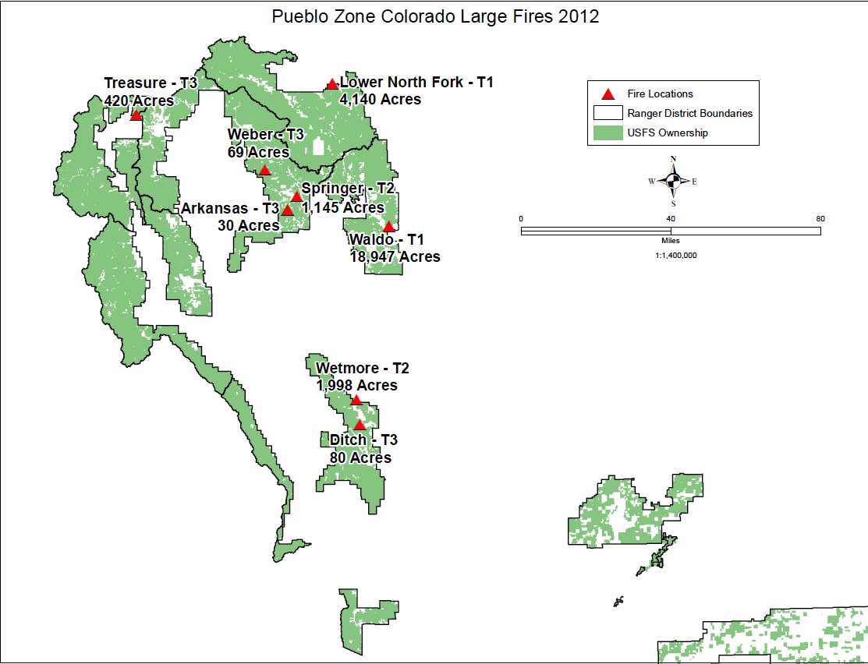
Pueblo Zone Colorado Large Fires

Slide 48
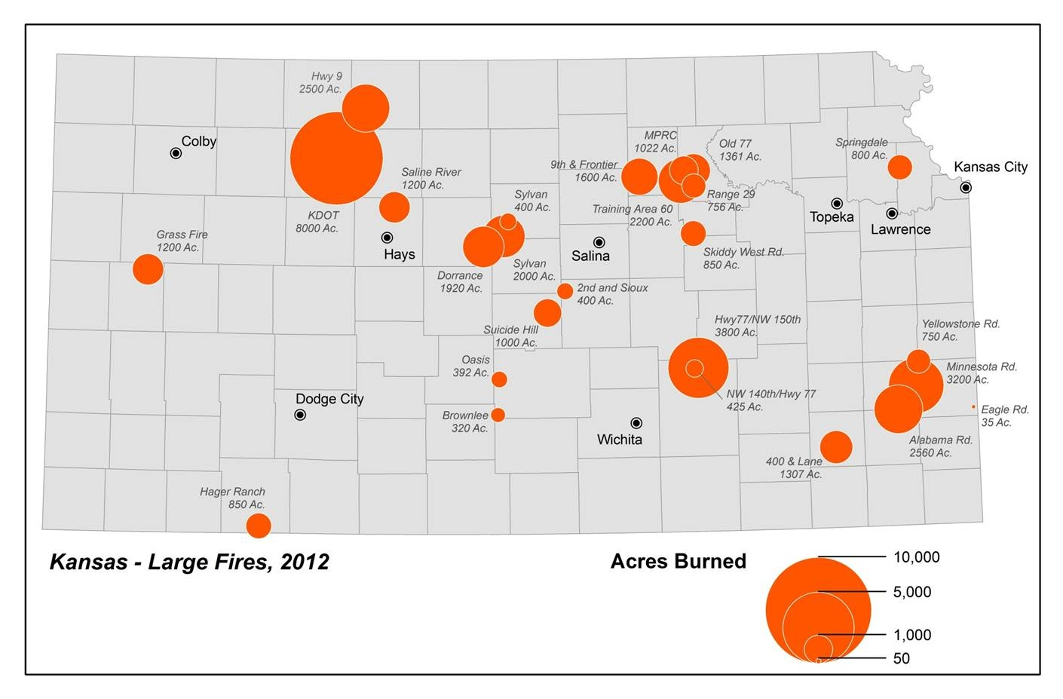
Pueblo Zone Kansas Large Fires

Slide 49
2012 Final Situation Report
Dispatch Office Summary Situation Report 12/31/2012- Pueblo Dispatch

Slide 50
Dispatch Office Summary Situation Report 12/31/2012 – Pueblo Dispatch
Year-to-Date |  | Wildland Fire Activity |  |  |  |  |  | Rx Fire Activity
Agency | State Unit | Human |  | Lightning |  | Total |  | Rx
 |  | Fires | Acres | Fires | Acres | Fires | Acres | Fires | Acres
BIA | KS-HOA | 15 | 1,164 | 0 | 0 | 15 | 1,164 | 7 | 640
BIA | Total: | 15 | 1,164 | 0 | 0 | 15 | 1,164 | 7 | 640
BLM | CO-RGD | 5 | 393 | 16 | 34 | 21 | 427 | 3 | 68
BLM | CO-SLD | 2 | 0 | 1 | 0 | 3 | 0 | 0 | 0
BLM | Total: | 7 | 393 | 17 | 34 | 24 | 427 | 3 | 68
CNTY | CO-CFX | 2 | 0 | 2 | 0 | 4 | 0 | 2 | 0
CNTY | CO-CUX | 2 | 1,607 | 4 | 0 | 6 | 1,607 | 0 | 0
CNTY | CO-DGX | 2 | 0 | 0 | 0 | 2 | 0 | 1 | 45
CNTY | CO-EPX | 8 | 3,831 | 0 | 0 | 8 | 3,831 | 0 | 0
CNTY | CO-FRX | 3 | 2 | 3 | 5 | 6 | 7 | 0 | 0
CNTY | CO-HUX | 0 | 0 | 1 | 0 | 1 | 0 | 0 | 0
CNTY | CO-JEX | 11 | 4,209 | 7 | 2 | 18 | 4,211 | 3 | 65
CNTY | CO-LCX | 2 | 12 | 0 | 0 | 2 | 12 | 0 | 0
CNTY | CO-LSX | 2 | 15 | 2 | 7 | 4 | 22 | 0 | 0
CNTY | CO-PAX | 7 | 6 | 6 | 2 | 13 | 8 | 2 | 0
CNTY | CO-PBX | 10 | 566 | 3 | 0 | 13 | 566 | 3 | 0
CNTY | CO-PUX | 2 | 152 | 0 | 0 | 2 | 152 | 0 | 0
CNTY | CO-TLX | 18 | 15 | 1 | 1 | 19 | 16 | 2 | 0
CNTY | KS-KSX | 29 | 33,910 | 3 | 4,225 | 32 | 38,135 | 1 | 0
CNTY | Total: | 98 | 44,325 | 32 | 4,242 | 130 | 48,567 | 14 | 110

Slide 51
Dispatch Office Summary Situation Report 12/31/2012 – Pueblo Dispatch
Year-to-Date |  | Wildland Fire Activity |  |  |  |  |  | Rx Fire Activity
Agency | State Unit | Human |  | Lightning |  | Total |  | Rx
 |  | Fires | Acres | Fires | Acres | Fires | Acres | Fires | Acres
DDQ | CO-FCQ | 1 | 0 | 0 | 0 | 1 | 0 | 0 | 0
DDQ | KS-DDQ | 5 | 11,617 | 0 | 0 | 5 | 11,617 | 0 | 0
DDQ | Total: | 6 | 11,617 | 0 | 0 | 6 | 11,617 | 0 | 0
FWS | CO-ALR | 0 | 0 | 1 | 150 | 1 | 150 | 0 | 0
FWS | KS-FLR | 4 | 103 | 0 | 0 | 4 | 103 | 16 | 4,428
FWS | KS-KIR | 0 | 0 | 1 | 0 | 1 | 0 | 1 | 7
FWS | KS-MCR | 8 | 179 | 0 | 0 | 8 | 179 | 10 | 1,206
FWS | KS-QUR | 0 | 0 | 2 | 0 | 2 | 0 | 3 | 3,241
FWS | Total: | 12 | 282 | 4 | 150 | 16 | 432 | 30 | 8,882
NPS | CO-FFP | 1 | 0 | 0 | 0 | 1 | 0 | 0 | 0
NPS | CO-GSP | 0 | 0 | 1 | 0 | 1 | 0 | 1 | 1
NPS | KS-TGP | 2 | 809 | 0 | 0 | 2 | 809 | 4 | 1,469
NPS | Total: | 3 | 809 | 1 | 0 | 4 | 809 | 5 | 1,470
ST | CO-PBS | 1 | 0 | 2 | 1 | 3 | 1 | 2 | 3
ST | KS-KSS | 1 | 1,600 | 0 | 0 | 1 | 1,600 | 0 | 0
ST | Total: | 2 | 1,600 | 2 | 1 | 4 | 1,601 | 2 | 3
USFS | CO-PSF | 61 | 16,649 | 43 | 154 | 104 | 16,803 | 10 | 447
USFS | CO-RGF | 5 | 1 | 10 | 2 | 15 | 3 | 5 | 130
USFS | KS-PSF | 0 | 0 | 1 | 0 | 1 | 0 | 0 | 0
USFS | Total: | 66 | 16,650 | 54 | 156 | 120 | 16,806 | 15 | 577
Grand Total: |  | 209 | 76,840 | 110 | 4,583 | 319 | 81,423 | 76 | 11,750

